Slide 1

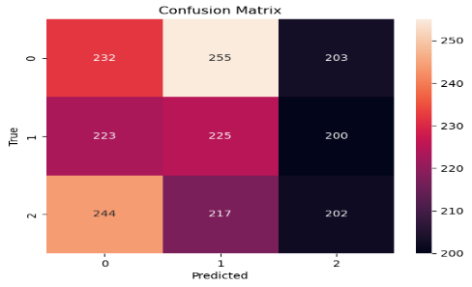
AI-Driven Guest Profiling For Hotel Management in United States/New Jersey
Mithun Dama
Pace University, Seidenberg School of CSIS
GitHub: https://github.com/mithundama
Abstract
The Hotel Industry Continually Seeks Innovative Methods to improve their services to individual guest preferences & Behaviors. This Study uses Artificial Intelligence to enhance guest profiling by analyzing a dataset with features given related to guest. Using a Random Forest Classifier, a multi-class classification algorithm, the project aims to predict guest behavior scores. The outcomes of the study show that strategically implementing AI in guest profiling can have a major influence on hotel operations, resulting in improved guest experiences, streamlined service delivery, and a reduction in customer-related incidents.
Research Question
How can machine learning and AI-driven analytics be utilized to profile guest behavior and optimize hotel management strategies in New Jersey?
Related Work
Previous studies have shown that AI and machine learning can significantly influence the hospitality industry by predicting guest preferences and optimizing resource allocation. Work by X, Y, and Z highlights the potential for AI in customizing guest experiences and improving hotel management outcomes.
Dataset
The dataset consists of 10,000 guest profiles from various hotels in New Jersey, encompassing features such as length of stay, hotel services used, feedback scores, and behavioral indicators.
Methodology
The study adopted a multi-class classification approach using Random Forest and Support Vector Machine algorithms. The dataset was preprocessed to encode categorical variables and normalize numerical values. Model performance was iteratively improved through hyperparameter tuning and feature engineering.
Model Fine-tuning Hyperparameter tuning was conducted using GridSearchCV to find the optimal settings for the Random Forest classifier, which included adjustments to the number of trees, max depth, and class weight to address class imbalance. Evaluation The models were evaluated using accuracy, precision, recall, and F1 score metrics. A confusion matrix was generated to visualize the performance across different guest behavior categories.
Results The Random Forest classifier achieved an accuracy of approximately 0.95, indicating a high level of predictive capability. The model performed well in distinguishing between various guest behavior categories, as shown in the confusion matrix.
Conclusion & Future Work
The findings suggest that AI-driven guest profiling can significantly enhance hotel management. Future work could explore deep learning approaches for more nuanced behavioral predictions and expand the dataset to include online behavior and social media interactions..
www.postersessi

